Slide 1
Computer Network and Communication
CNS3200

Slide 2
Learning Outcome
EXPLAIN AND CALCULATE MULTIPLEXING METHOD OF FREQUENCY DIVISION MULTIPLEXING (FDM) AND WAVELENGTH DIVISION MULTIPLEXIING (WDM) (C4, NS) EXPLAIN THE METHODS OF GUIDED & UNGUIDED MEDIA TRANSMISSION (C4) DIFFERENTIATE PACKET AND CIRCUIT SWITCHING (C4)

Slide 3

Taxonomy of switched networks

Slide 4

CIRCUIT-SWITCHED NETWORKS
A circuit-switched network consists of a set of switches connected by physical links.
A connection between two stations is a dedicated path made of one or more links.
However, each connection uses only one dedicated channel on each link.
Each link is normally divided into n channels by using FDM or TDM.
A trivial circuit-switched network

Slide 5

Example 1
As a trivial example, let us use a circuit-switched network to connect eight telephones in a small area. Communication is through 4-kHz voice channels. We assume that each link uses FDM to connect a maximum of two voice channels. The bandwidth of each link is then 8 kHz. Figure 8.4 shows the situation. Telephone 1 is connected to telephone 7; 2 to 5; 3 to 8; and 4 to 6. Of course the situation may change when new connections are made. The switch controls the connections.

Slide 6
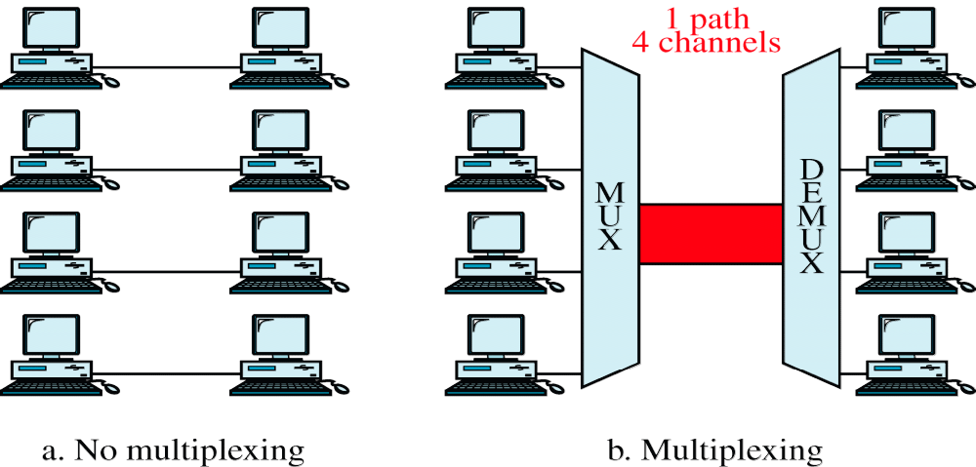
WCB/McGraw-Hill

Slide 7
1. Multiplexing
Multiplexing is a set of techniques that allows the simultaneous transmission of multiple signals across a single data link.
Today there are many technologies can accommodate high bandwidth, i.e optical fiber and satellite microwave.
Each has a bandwidth far in excess of that needed for the average transmission signal.
If the bandwidth of a link is greater than the bandwidth needs of the devices connected to it, the bandwidth is wasted.
Bandwidth is the precious thing in data communication.

Slide 8
In multiplexed system, n lines share the bandwidth of one link.
The sender is a multiplexer (MUX).
The receiver is a demultiplexer (DEMUX)
Link refer to the physical path.
Channel refer to the portion of a link that carries a transmission between a given pair of lines.
One link can have many (n) channels.
There are 3 basic multiplexing techniques,
  Frequency Division Multiplexing (Analog)
  Wavelength Division Multiplexing (Analog)
  Time Division Multiplexing (Digital)

Slide 9
2. Frequency- Division Multiplexing
FDM is analog technique can be applied when the bandwidth of a link (in hertz) is greater than the combined bandwidth of the signals to be transmitted.
Channels can be separated by strips of unused bandwidth – guard bands.
Guard bands – to prevent signals from overlapping

Slide 10

Example 2

Slide 11
3. Wavelength-Division Multiplexing
Conceptually same as FDM, except that the multiplexing and demultiplexing involve light signals transmitted through fiber optics channels.
The idea is same:”Combining different signals of different frequencies” the difference is that the frequencies are very high.
Very narrow bands of light from sources are combined to make a wider band of light.
How to combine multiple light sources into one single light at multiplexer??→ Use prism.
Prism bends a beam of light based on the angle of incidence and the frequency.

Slide 12
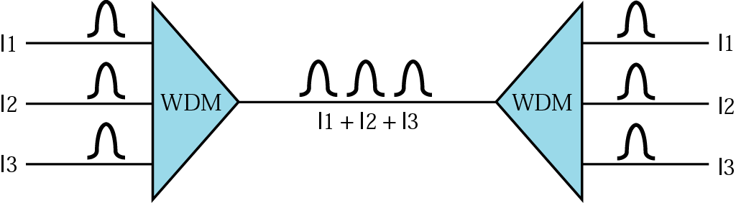

Slide 13
4.Time-Division Multiplexing(TDM)
a digital process that can be applied when the data rate capacity of transmission medium is greater than the data rate required by the sending and receiving devices.
Multiple transmissions can occupy a single link by subdividing them and interleaving the portions.
The link is shown sectioned by time rather than frequency.
Implemented in two ways: synchronous TDM and asynchronous TDM.

Slide 14
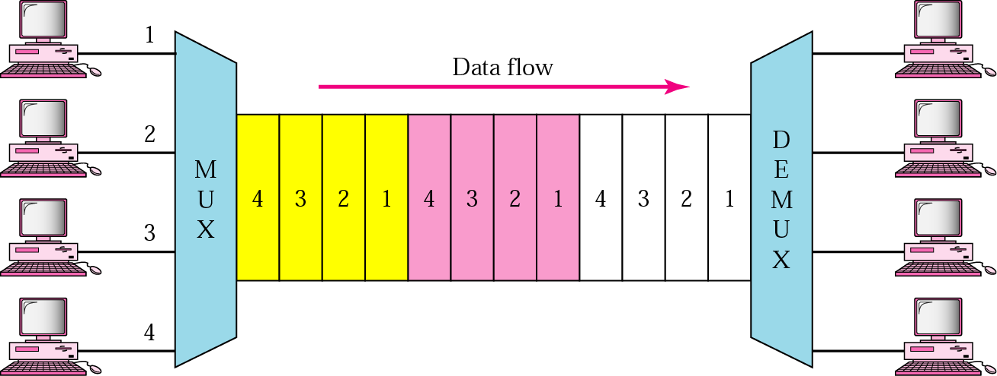
TDM

Slide 15
Synchronous TDM
Synchronous means that the multiplexer allocates exactly the same time slot to each device at all times, whether or not device has anything to transmit.
Frames:
  Time slots are grouped into frames.
  A frame consists of one complete cycle of time slots, including one or more slots dedicated to each sending device
  In a system with n input lines, each frame has at least n slots.

Slide 16
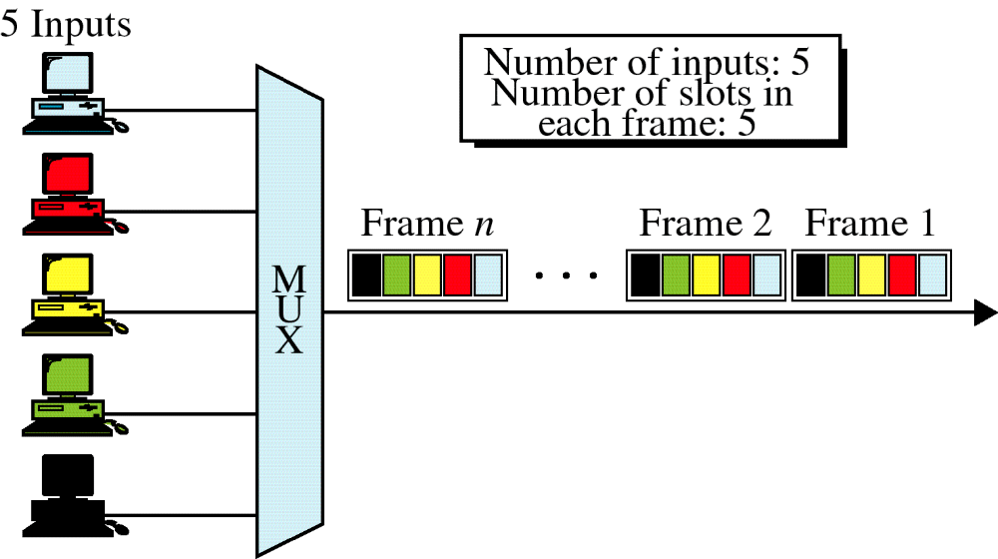
Synchronous TDM

Slide 17
Synchronous TDM
Interleaving:
  Synchronous TDM can be compared to a very fast rotating switch.
  The switch moves from device to device at a constant rate and in a fixed order - interleaving.
  Interleaving can be done by bit, by byte, or by any other data unit.
Framing bits:
  The order of receipt tells the demultiplexer where to direct each time slot – so, no addressing required.

Slide 18
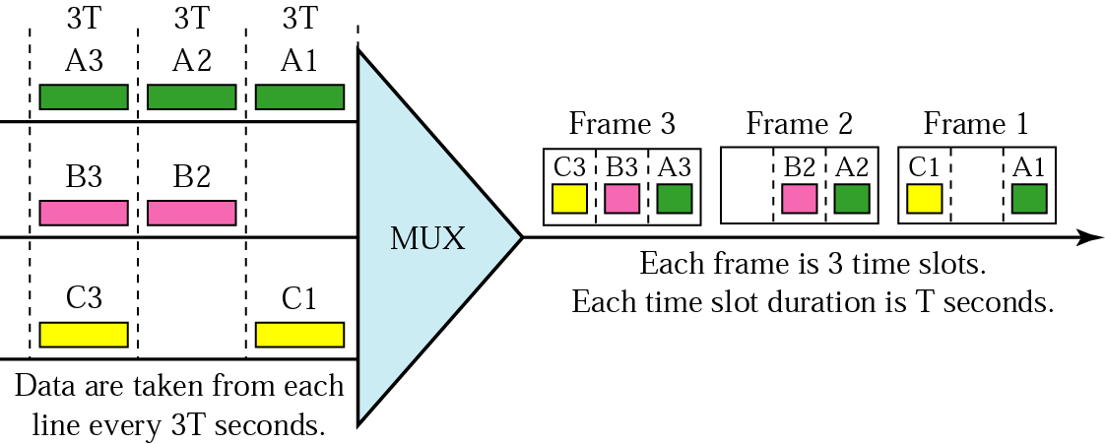
TDM frames

Slide 19
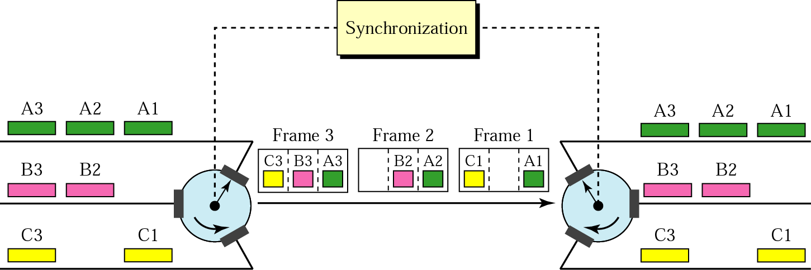
Interleaving

Slide 20
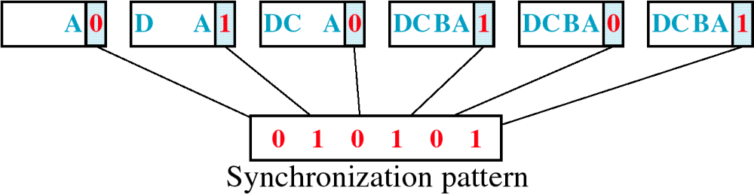
Framing Bits
Alternate 0s and 1s

Slide 21
Example 3
Four 1-Kbps connections are multiplexed together. A unit is 1 bit. Find:
The duration of 1 bit before multiplexing 1/1 Kbps= 0.001 s (1 ms)
2. The transmission rate of the link is 4 x rate of a connection = 4 Kbps
3. The duration of each time slot = 1ms /4 or 250 μs
4. The duration of a frame = duration of 1 unit before multiplexing => 1 ms

Slide 22

Solution for Example 3
2
4
Data 1 connection = 1 Kbps
4 connections = 4 x 1 Kbps = 4 Kbps
A. Duration 1 frame = duration 1 bit
= 1ms
B. Duration 1 frame = 4 time slots
= 4 x 250μs = 1ms
1 Kbps
1 Kbps
1 Kbps
3
A. Duration 1 time slot = ¼ duration 1 bit
= 1 ms x ¼
= 0.25 ms = 250μs
B. Duration 1 time slot = 1 / data rate
= 1 / 4 Kbps
= 0.25 ms = 250μs
1 Kbps
1
1 Kbps = 1000 bit … 1 second
1 bit = 1 / 1000 = 0.001 second = 1ms

Slide 23
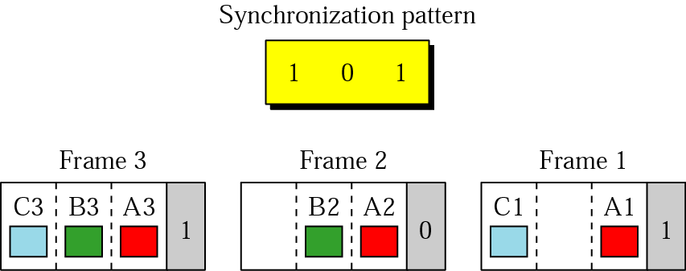
Framing bits

Slide 24
Example 4 - optional
We have four sources, each creating 250 characters per second. If the interleaved unit is a character and 1 synchronizing bit is added to each frame;
1. The data rate of each source :
2. The duration of a character :
3. The frame rate :
4. The duration of each frame :
5. Frame size :
6. Data rate of output link :
8 bits x 250 = 2000bps
1/250 s, or 0.004s = 4ms
250 frames per second
1 s/250 = 4 ms
4 time slots x 8 bits + 1 bit = 33 bits.
250 frame x 33bits /s = 8250 bps

Slide 25

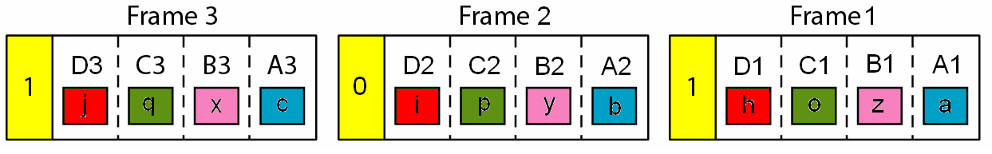
Extra: Slide
Solution for Example 4
1
3
4
Data rate 1 source = 250 char x 8 bits
= 2000bps
* 1 char = 8 bits
Frame rate
= transmission rate
= 250 frames/sec
Duration 1 Frame
= 1/250
= 4ms
a b c d e f ...
A
z y x w v u ...
B
o p q r s t ...
C
5
h i j k l m ...
1 Frame contains = 4 chars + 1 sync bit
= (4 chars x 8bit ) + 1bit
= 33 bits
D
2
Duration of 1 char = 1 / 250
= 4 ms
6
Data rate = frame rate x bits per frame
= 250 X 33 bits
= 8250 bps

Slide 26
Example 5
Four channels are multiplexed using TDM. If each channel sends 100 bytes/s and we multiplex 1 byte per channel, show the frame traveling on the link, the size of the frame, the duration of a frame, the frame rate, and the bit rate for the link.
Solution
The multiplexer is shown in the next figure

Slide 27
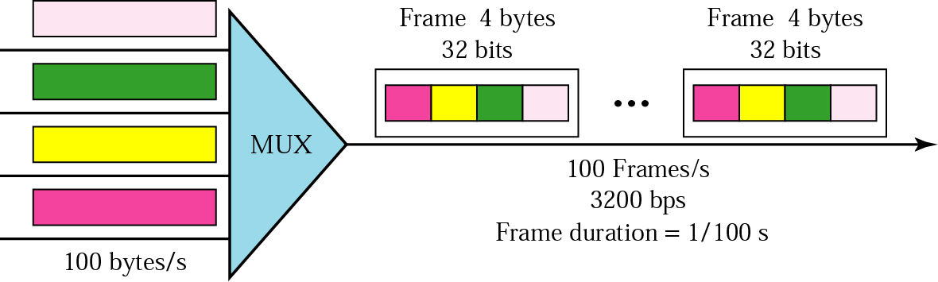
Example 5

Slide 28
Example 6
A multiplexer combines four 100-Kbps channels using a time slot of 2 bits. Show the output with four arbitrary inputs. What is the frame rate? What is the frame duration? What is the bit rate? What is the bit duration?
Solution
The next figure shows the output for four arbitrary inputs.

Slide 29
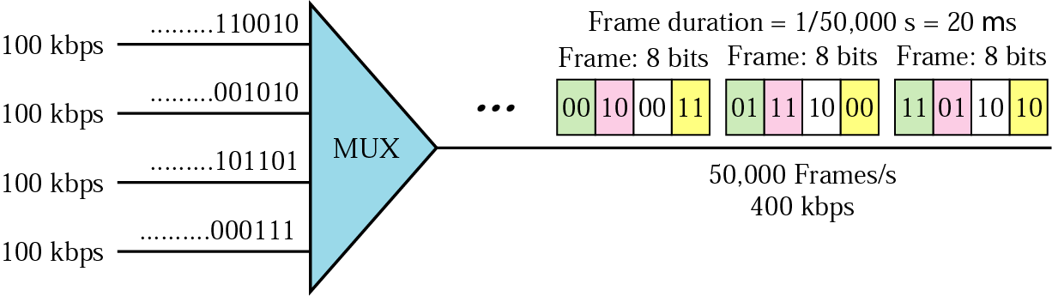
Example 6
20μs

Slide 30
Example 7
Two channels, one with a bit rate of 100 Kbps and another with a bit rate of 200 Kbps, are to be multiplexed. How this can be achieved? What is the frame rate? What is the frame duration? What is the bit rate of the link?
Solution
We can allocate one slot to the first channel and two slots to the second channel. Each frame carries 3 bits. The frame rate is 100,000 frames per second because it carries 1 bit from the first channel. The frame duration is 1/100,000 s, or 10 ms. The bit rate is 100,000 frames/s x 3 bits/frame, or 300 Kbps.

Slide 31
Asynchronous TDM
Synchronous TDM does not guarantee that the full capacity of a link is used.
Because the time slots are preassigned and fixed, whenever a connected device is not transmitting, the corresponding slot is empty and that much of the path is wasted.
Asynchronous TDM (also called statistical TDM) is designed to avoid this type of waste.
Asynchronous means flexible or not fixed.
Unlike synchronous TDM, in asynchronous TDM the total speed of the input lines can be greater than the capacity of the path.

Slide 32
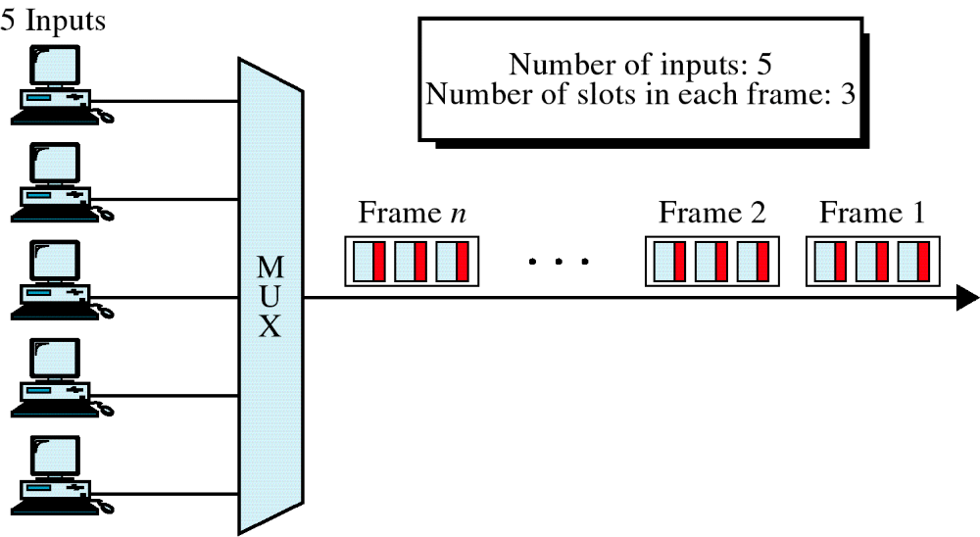
Asynchronous TDM

Slide 33
Asynchronous TDM
If we have n input lines, the frame contains no more than m slots, with m < n.
Given the same link, asynchronous TDM can support more devices.
m is based on the number of input lines that are likely to be transmitted at any given time.
Time slots allocated dynamically.

Slide 34
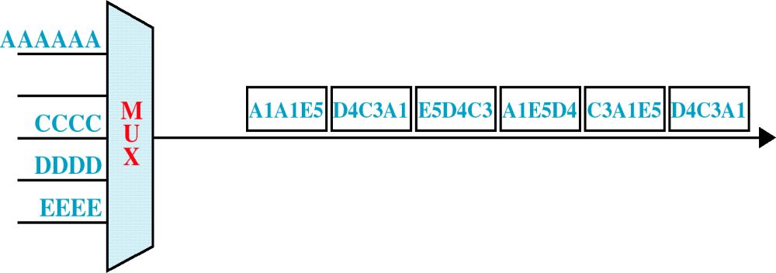
Frames and Addresses
Addressing and Overhead
  Each time slot must carry an address telling the demultiplexer how to direct the data.
  This address is attached by the multiplexer and discarded by the demultiplexer.

Slide 35
Transmission Media

Slide 36
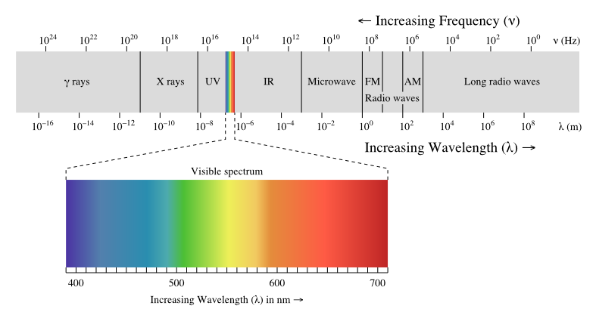
Electromagnetic Signals

Slide 37
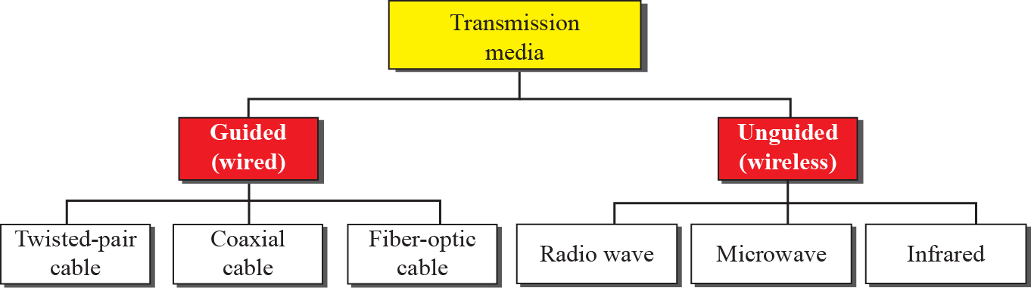
7.<number>
Notes:
7.#

Slide 38
Guided Media
uses conduit from one device to another.
signal is directed and contained by the physical limits of the medium.
Twisted pair & coaxial cable – deal with electrical current.
Fiber optic – deal with light.

Slide 39
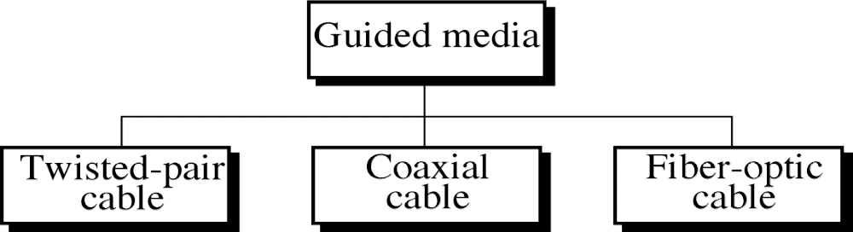
Guided Media

Slide 40
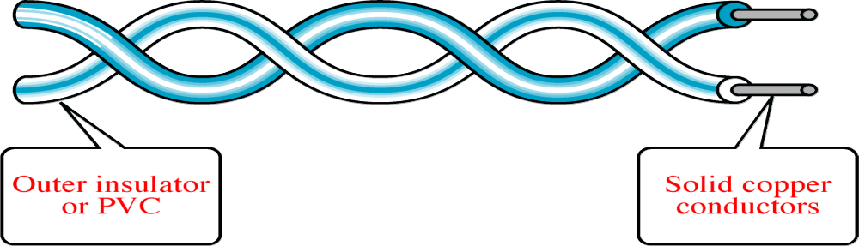
Twisted-Pair Cable
Unshielded Twisted Pair (UTP):
  suitable for voice and data transmission.
  consists of two conductors/copper, each with its own colored plastic insulation.
  Why use twisted instead of (untwisted)?

Slide 41
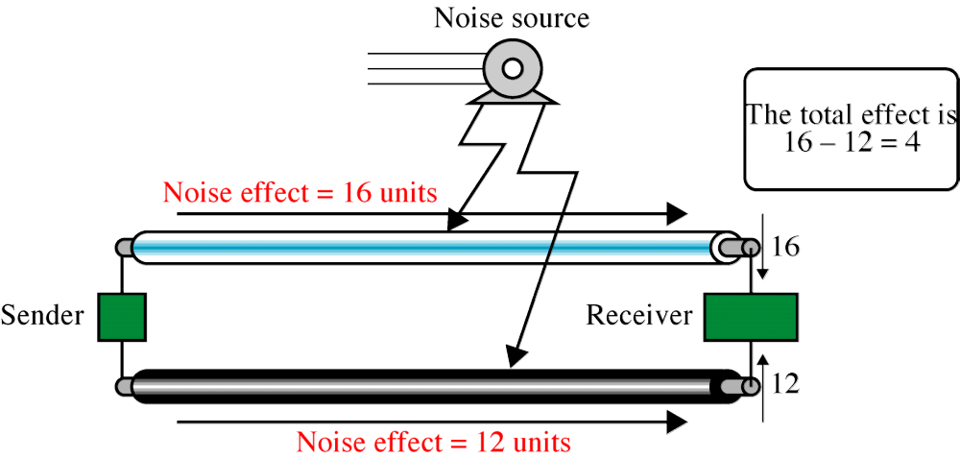
Effect of Noise on Parallel Lines

Slide 42
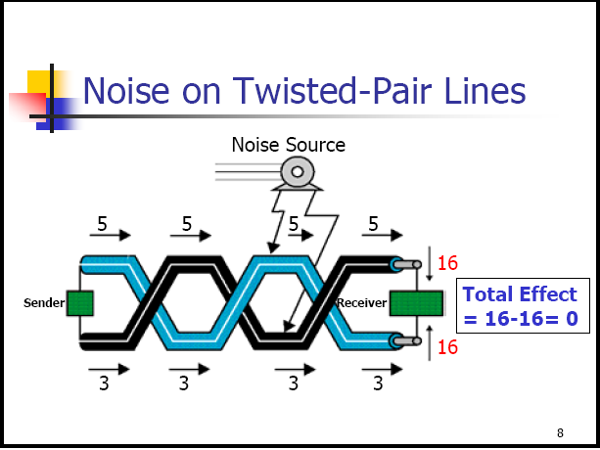

Slide 43
Twisted-Pair Cable
  Thin and flexible
  Small, it does not quickly fill up wiring ducts.
  Cheap
  EIA has developed standards to grade UTP cables:
    Cat 3: Used for data networks using frequencies up to 16 MHz. Historically popular for 10 Mbit/s Ethernet networks.
    Cat 5e: Provides for up to 100 MHz, and is frequently used for both 100 Mbit/s and Gigabit Ethernet networks.
    Cat 6: Provides for up to 250 MHz, more than double category 5 and 5e - 200 Mbit/s
    Cat 6a: Future specification for 10 Gbit/s applications.
    Cat 7: Designed for transmission at frequencies up to 600 MHz.

Slide 44
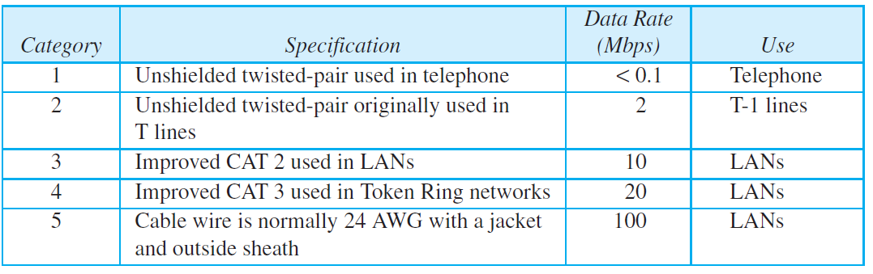
7.<number>

Slide 45
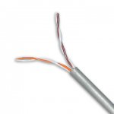
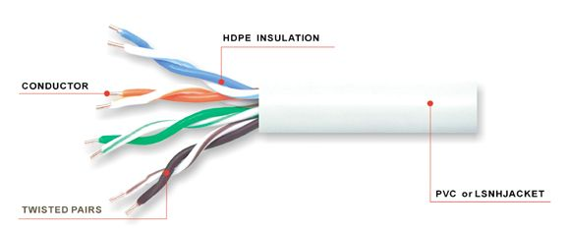
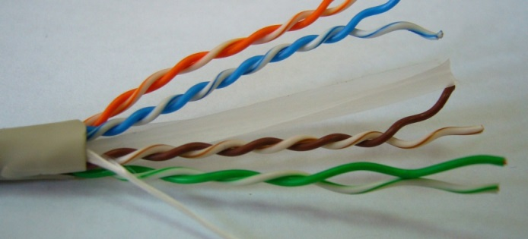
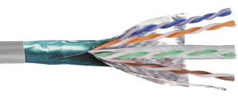
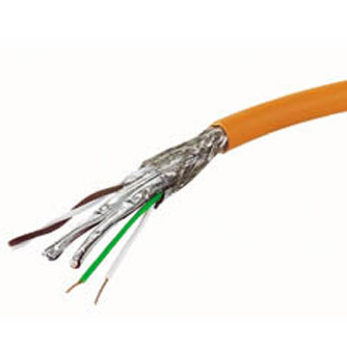
Cat 3
Cat 5e
Cat 6
Cat 7
Cat 6a

Slide 46
Twisted Pair Cable
Shielded Twisted-Pair cable (STP):
  Has a metal foil/braided-mesh covering that encases each pair of insulated conductors.
  The metal casing prevents the penetration of electromagnetic noise.
  Expensive than UTP but less susceptible to noise.
  Eliminates crosstalk
    It occurs when one line picks up some of the signals traveling down another line – telephone conversation.

Slide 47
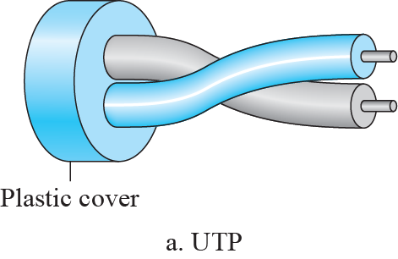
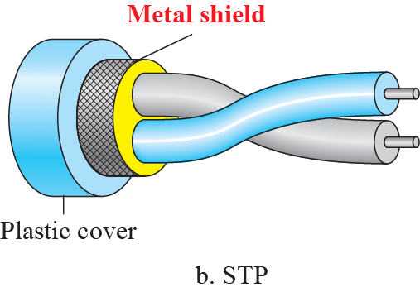
7.<number>
Notes:
7.#

Slide 48
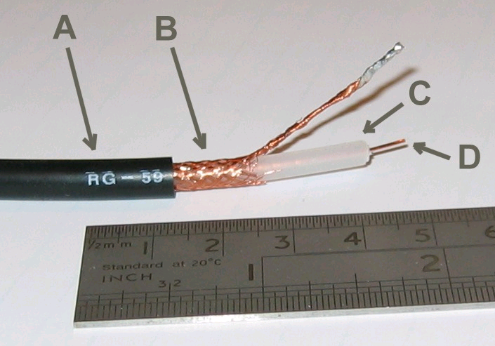
Coaxial Cable
Carries signals of higher frequency ranges than twisted pair.
Coax has a central core conductor of solid/stranded wire enclosed in an insulating sheath, and encased in an outer conductor of metal foil/braid.
Outer conductor - serves both as a shield against noise and as second conductor.
The outer also enclosed in an insulating sheath, and the whole cable protected by a plastic cover.
Radio-grade flexible coaxial cable.
A: outer plastic sheath
B: copper screen
C: inner dielectric insulator
D: copper core

Slide 49
Coaxial Cable
Different coax cable designs are categorized by their radio government (RG) ratings.
Few of the common coaxial cable standards:
  RG-8, RG-9, RG-11. – Used in thick Ethernet
  RG-58. Used in thin Ethernet, amateur radio
  RG-59. Used for CCTV

Slide 50
Optical Fiber
Optical fiber, is made of glass/plastic and transmit signals in the form of light.
Light is a form of electromagnetic energy, travels at 300,000 kilometers/second in a vacuum. This speed decreases as the medium through which the light travels becomes denser.

Slide 51
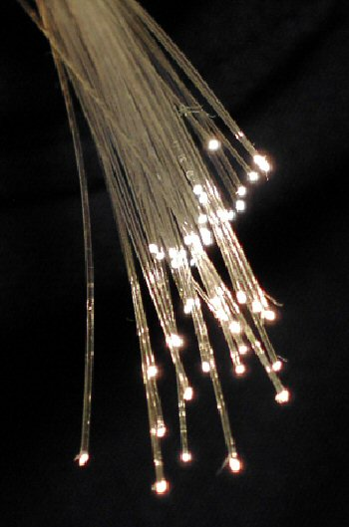
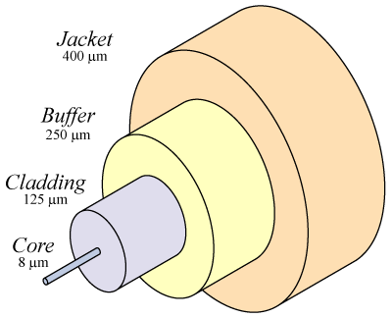

Slide 52
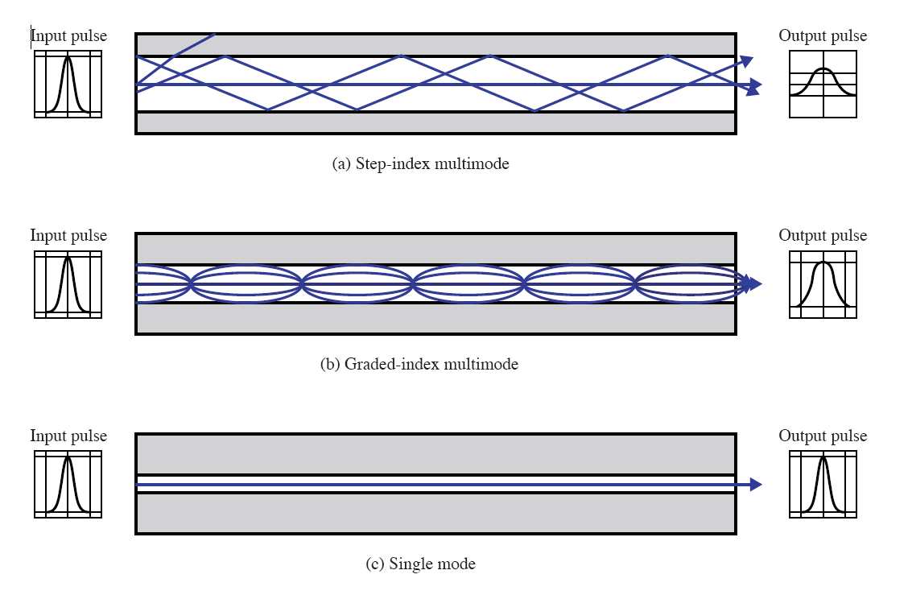

Slide 53
Fiber Optic
Advantages of Optical Fiber
  Noise resistance – use light rather than electricity, external light is blocked by the outer jacket
  Less signal attenuation - transmission distance is greater than that other guided media. Without requiring regeneration
  Higher bandwidth –compared to twisted-pair and coaxial cable
Disadvantages of Optical Fiber
  Cost – expensive manufacturing
  Installation/maintenance -sensitive
  Fragility – more easily broken than wire

Slide 54
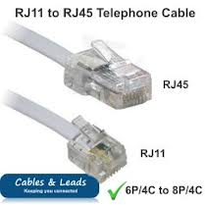
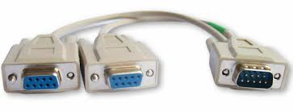
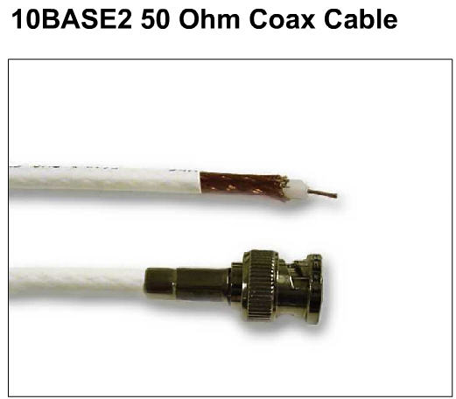
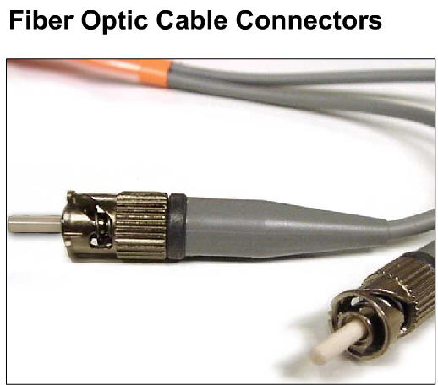
Connectors

Slide 55
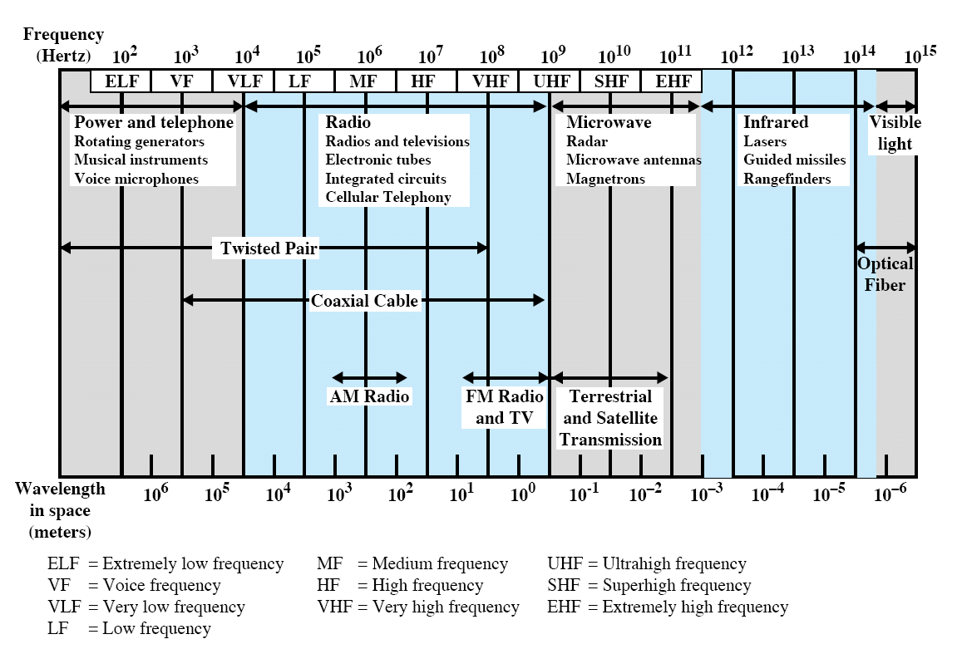
Electromagnetic Spectrum for Telecommunications

Slide 56
Unguided Media
Unguided media (wireless communication) transport electromagnetic waves without physical conductor
  Radio waves – 3kHz-1GHz
  Microwaves – 1GHz-300 GHz

Slide 57

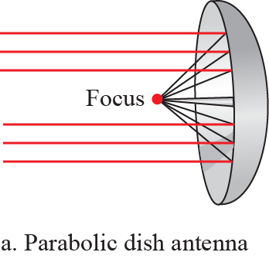
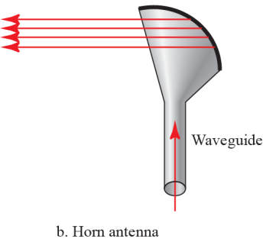
Unguided media
Omnidirectional
  RADIO Waves
  Signal radiates in all directions
  Good for broadcast
  Inexpensive antenna
  High interference
  Radio, normal TV
Directional
  MICRO waves
  Signal radiates in a single direction
  Usually requires parabolic (dish) antenna
  2-40 GHz (microwave)
  Also works with lasers
  Cable TV (ASTRO)
Omnidirectinal anttena

Slide 58
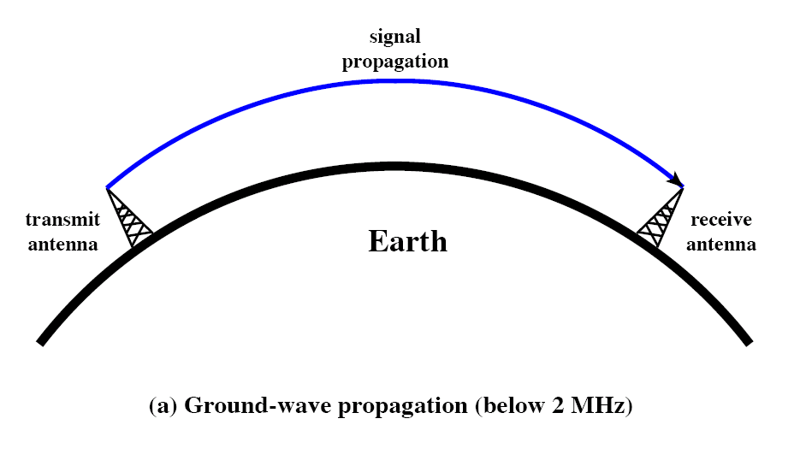
Ground propagation
-Lowest portion of atmosphere
-Follows earth’s contour

Slide 59
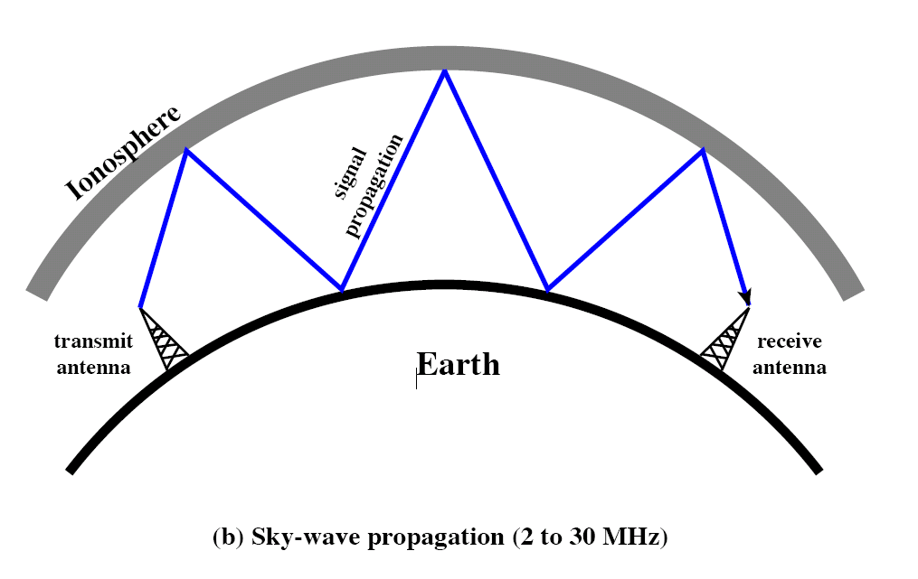
Sky propagation
Signal reflected at the ionosphere.

Slide 60
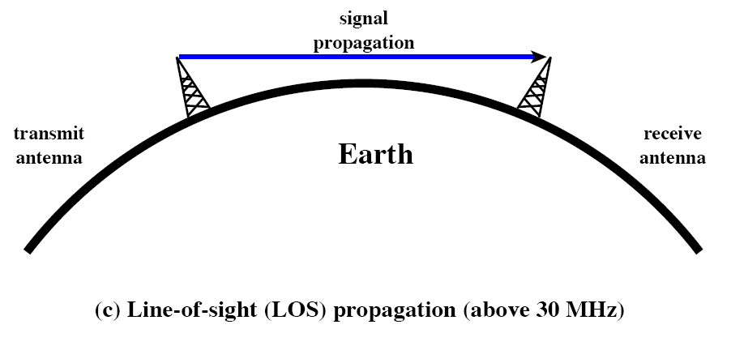
Line-of-sight propagation
Effective straight line with antennas facing each other

Slide 61
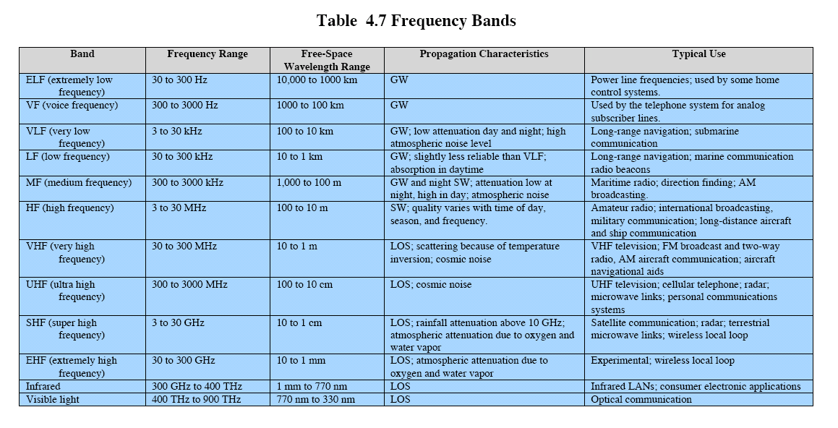

Slide 62
Terrestrial Microwave
Two types of antenna are used: parabolic dish and horn
Parabolic dish antenna – based on geometry of a parabola: every line parallel to the line of symmetry (line-of-sight) reflects off the curve at angles such that they intersect in a common point called the focus.
Horn antenna – Outgoing transmission are broadcast up a stem (resembling a handle) and deflected outward in a series of narrow parallel beams by the curved head.

Slide 63
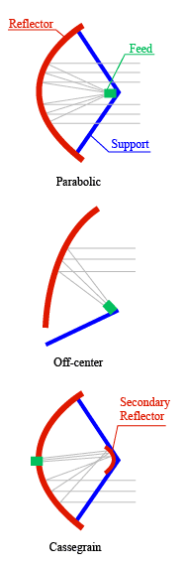
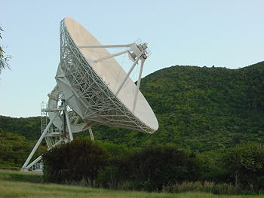

Slide 64
Infrared
Infrared waves, with frequencies from 300 GHz to 400 THz (wavelengths from 1 mm to 770 nm), can be used for short-range communication. Infrared waves, having high frequencies, cannot penetrate walls. This advantageous characteristic prevents interference between one system and another; a short-range communication system in one room cannot be affected by another system in the next room. When we use our infrared remote control, we do not interfere with the use of the remote by our neighbors.
7.<number>
Notes:
7.#

Slide 65
Satellite Communication
Much like line-of-sight microwave transmission in which one of the stations is a satellite orbiting the earth.
The principle is the same as terrestrial microwave, with satellite acting as a super tall antenna and repeater.
Satellite microwave can provide transmission capability to and from any location on earth, no matter how remote.

Slide 66
Satellite Communication
Geosynchronous Satellites
  The satellite move at the same speed as the earth to ensure constant communication.
  Because orbital speed is based on distance from the planet, only one orbit can be geosynchronous.
  One geosynchronous satellite cannot cover the whole earth.
  It takes a minimum of three satellites equitant from each other in geosynchronous orbit to provide full global transmission.

Slide 67
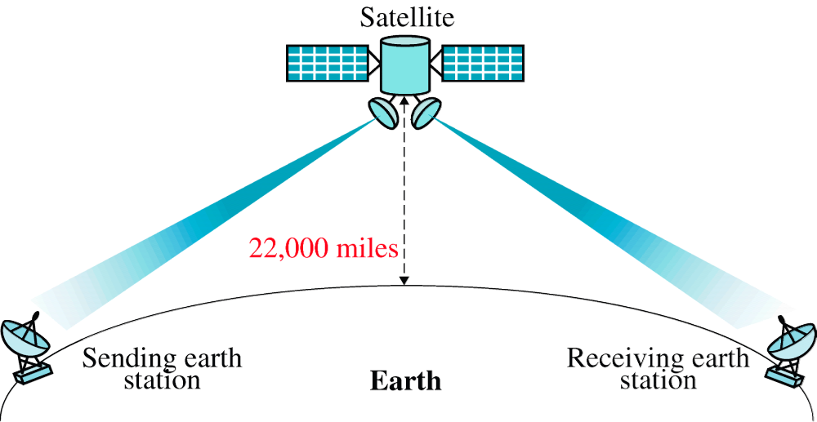
Satellite Communication

Slide 68
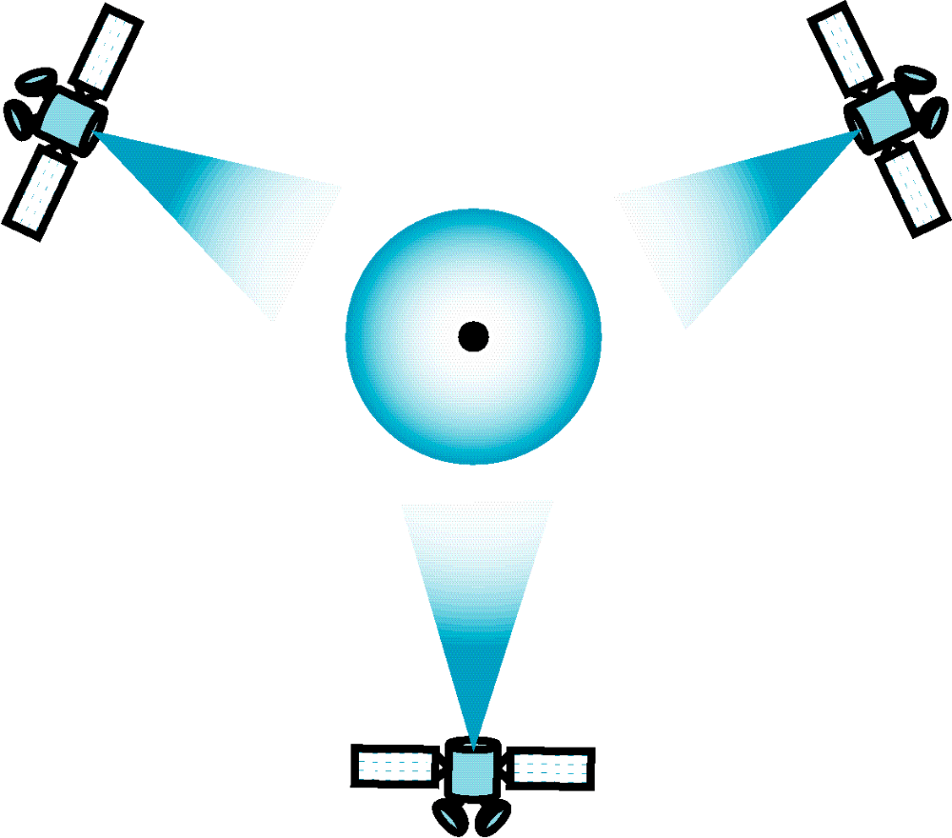
Geosynchronous Orbit

Slide 69
PROGRESS PROJECT

